Slide 1

Forest Buddy

Slide 2
Forest Buddy Team
Joshua Mcgee
Landon Garrett
Gerardo Hernandez
CS
Camera Vision
Data Analysis
Alten Reeves
Locomotion
Dr. Dylan Boyd
Faculty Advisor
Signal Processing
Lane Williams
Navigation/Localization
John Allen
PM
Communication

Slide 3
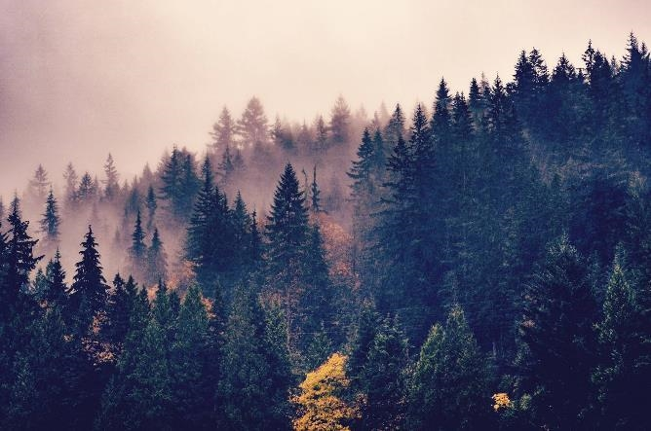


The Problem
What is the Problem?
Forests are increasingly afflicted by drought, pests, and diseases, raising concern as they remain an essential part of the environment.
11-16% of tree species are threatened by extinction due to pests and diseases [2].
Nearly 11% of forests in the U.S. are exposed to drought, expected to rise to 38% by mid-century [1].

Slide 4
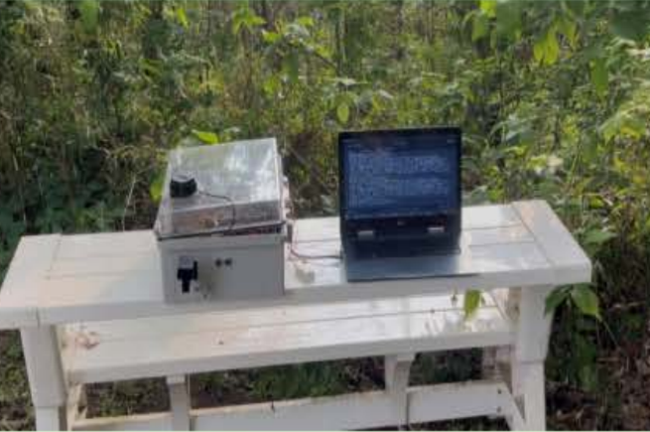
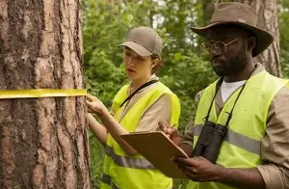
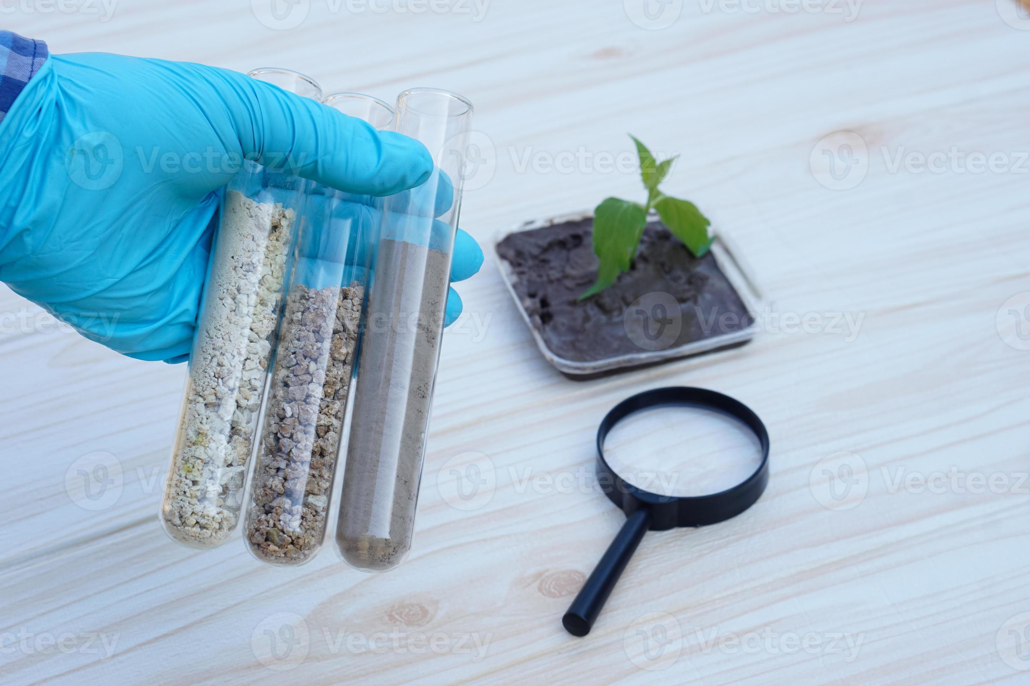
Previous Solutions
Leaf Link
Used a pulley system
Extremely limited mobility
Manual Inspection
Economical but impractical for inspecting large areas and often too late to detect disease [3][4].
Lab Testing
Fast and effective, but requires the tree to be cut, which harms the tree [3][4].

Slide 5
Competitive advantages
Catches disease earlier than manual methods
More time efficient
Inexpensive
Data collection is nonintrusive
Scalable

Slide 6
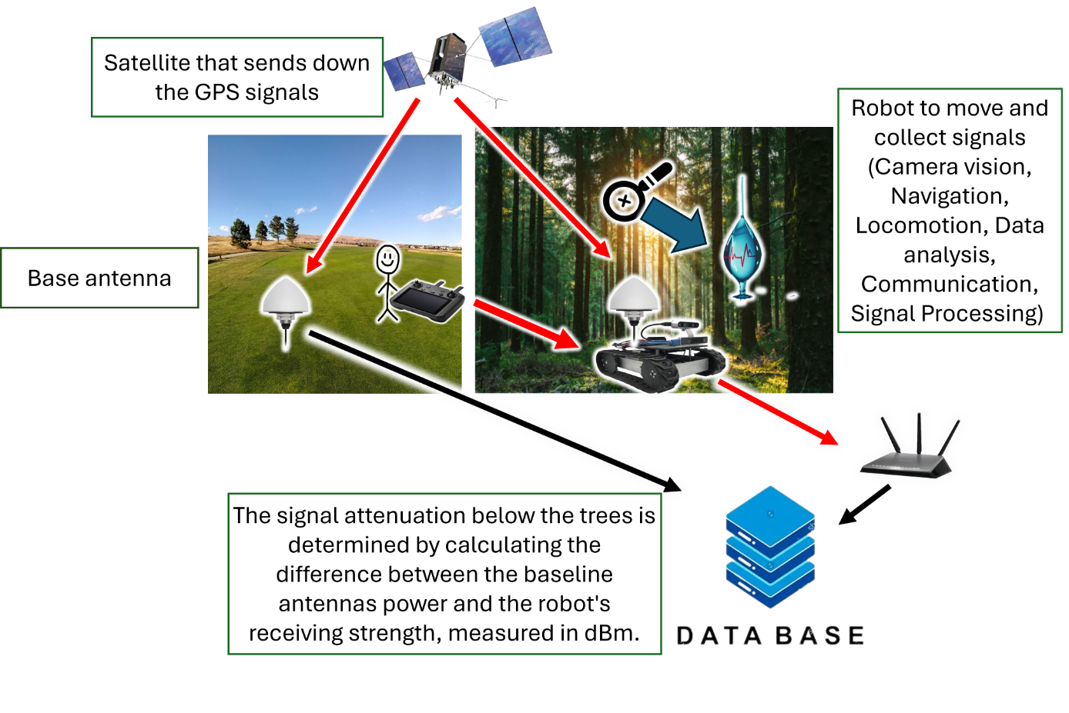
Unique Solution

Slide 7
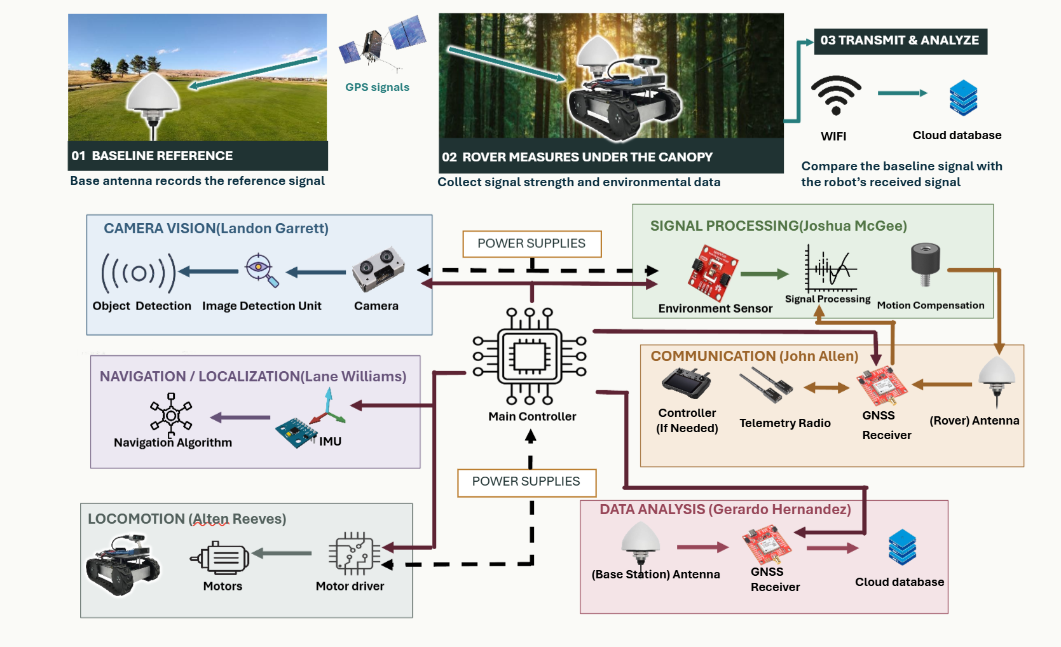
System Diagram

Slide 8
Features
1. The system must run for at least an hour, covering a large area with regulated power. 2. The system has precise and reliable human detection that can be done in a timely manner. 3. The system has precise localization and can maintain proper orientation. 4. The system does not run into obstacles and maintains proper following distance from the operator. 5. The system must be able to travel across terrain that is expected in a forest including stumps, exposed tree roots, overhanging branches and vines, mild slopes, mud, leaf litter, and debris.

Slide 9
Constraints
Type | Name | Description
Environmental | Weather | The Forest Buddy must operate in windspeeds of 10 mph and rainfall rates of 1mm of rainfall per minute per 10 minutes when tilted up to 15°.
Environmental | Terrain | Forest Buddy must operate in forested environments with a 20% grade and maneuver in broken ground of up to 2” in height.
Environmental | Obstacles | Forest Buddy must be able to drive over small debris typical of a forest environment. Including rocks, roots, sticks, limbs, leaves of up to 5” in height.
Safety | E-Stop | The rover must have a physical E- Stop button that stops all motor movement within 1 second of being pressed.
Functionality | Width | Forested lands often include trees that are 5’ – 10’ apart so the rover must be able to maneuver in between these trees.

Slide 10
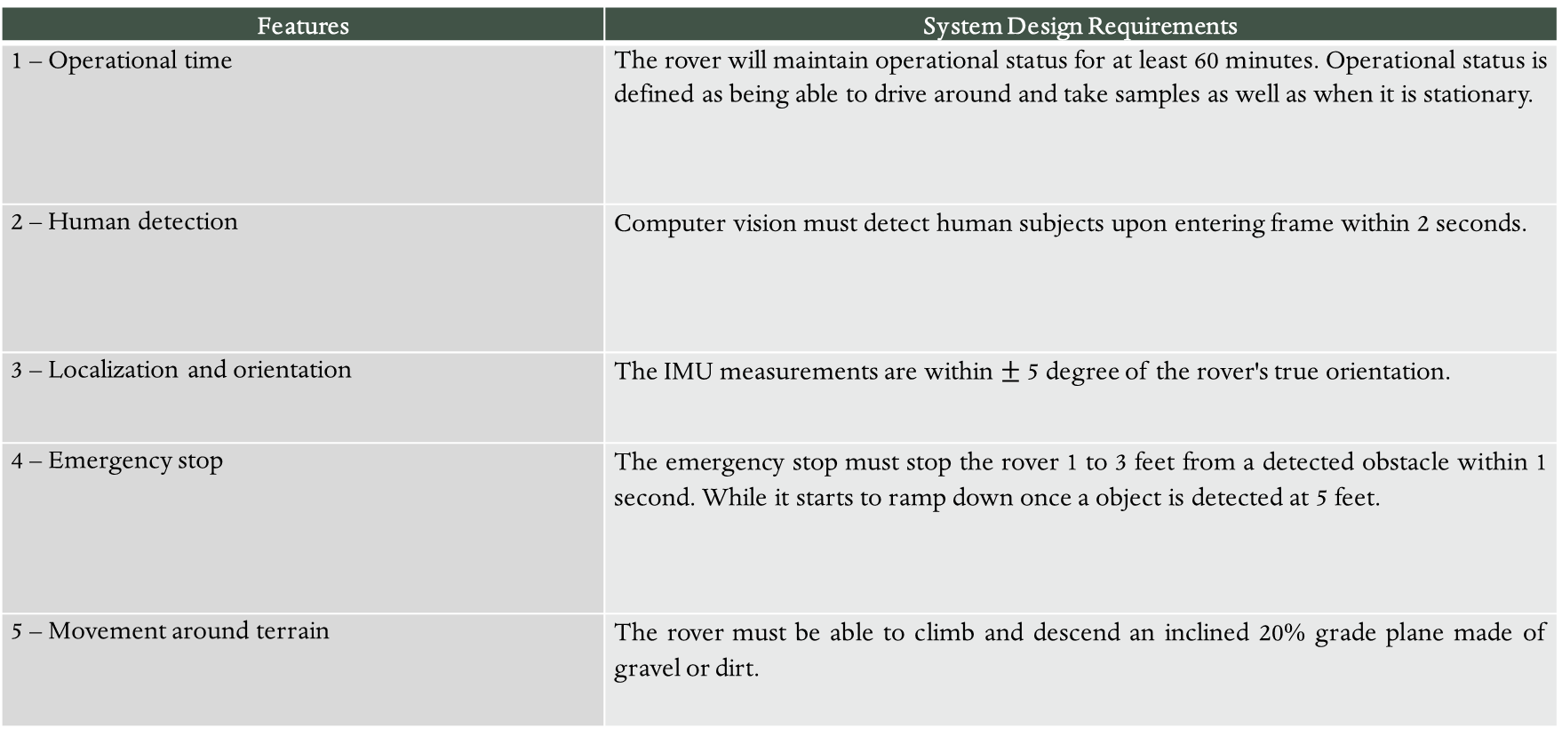
Requirements
Features | System Design Requirements
1 – Operational time | The rover will maintain operational status for at least 60 minutes. Operational status is defined as being able to drive around and take samples as well as when it is stationary.
2 – Human detection | Computer vision must detect human subjects upon entering frame within 2 seconds.
3 – Localization and orientation | The IMU measurements are within $±$ 5 degree of the rover's true orientation.
4 – Emergency stop | The emergency stop must stop the rover 1 to 3 feet from a detected obstacle within 1 second. While it starts to ramp down once a object is detected at 5 feet.
5 – Movement around terrain | The rover must be able to climb and descend an inclined 20% grade plane made of gravel or dirt.

Slide 11
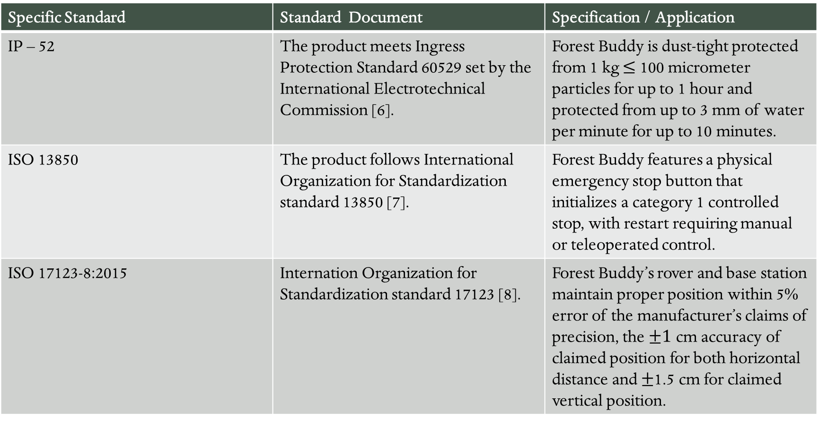
Standards
Specific Standard | Standard Document | Specification / Application
IP – 52 | The product meets Ingress Protection Standard 60529 set by the International Electrotechnical Commission [6]. | Forest Buddy is dust-tight protected from 1 kg $≤$ 100 micrometer particles for up to 1 hour and protected from up to 3 mm of water per minute for up to 10 minutes.
ISO 13850 | The product follows International Organization for Standardization standard 13850 [7]. | Forest Buddy features a physical emergency stop button that initializes a category 1 controlled stop, with restart requiring manual or teleoperated control.
ISO 17123-8:2015 | Internation Organization for Standardization standard 17123 [8]. | Forest Buddy’s rover and base station maintain proper position within 5% error of the manufacturer’s claims of precision, the $±1$ cm accuracy of claimed position for both horizontal distance and $±$1.5 cm for claimed vertical position.

Slide 12
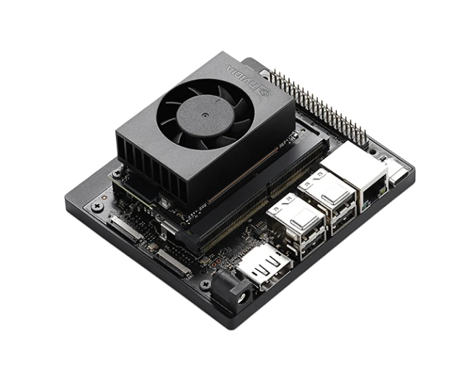
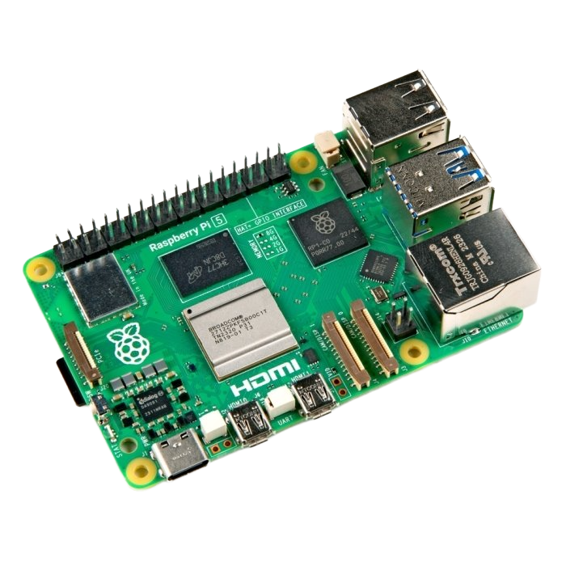
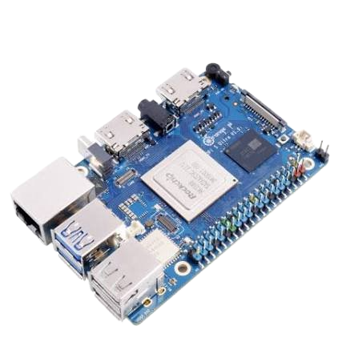
Major Component: Microcontroller
Microcontroller | Jetson Orin Nano | Raspberry Pi 5 (8 GB) | Orange Pi 5 Plus (8 GB)
Image
Cost | $400 | $180 | $225
RAM | 8 GB LPDDR5 | 8 GB LPDDR4X | 8 GB LPDDR4X
Power | 7 to 25 W | ~5 to 12 W | ~5 to 10 W
Interfaces | 40-pin header, 4 USB ports, 2 camera ports | 40-pin header, 4 USB ports, 2 camera ports | 26-pin header, 3 USB ports, 3 camera ports
Ai compute | 67 TOPS | None built in | 6 TOPS

Slide 13
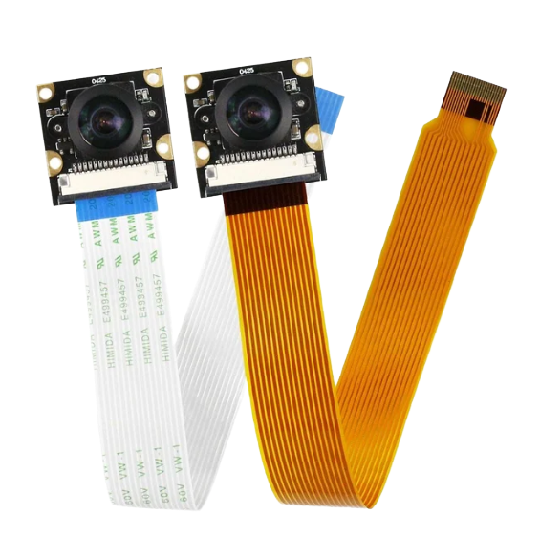
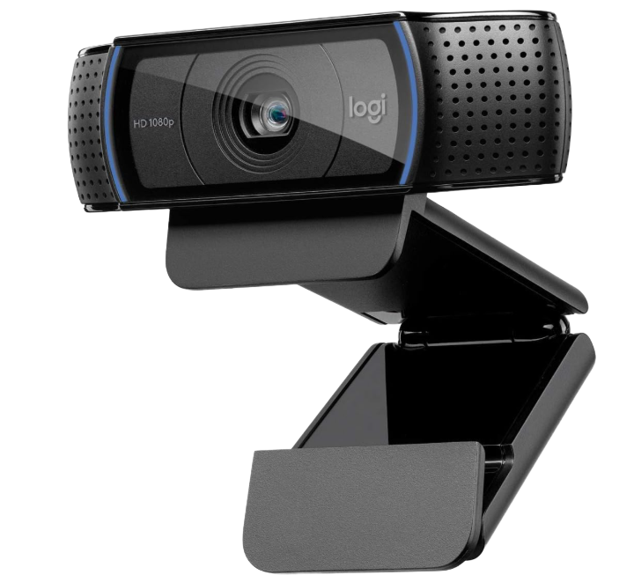
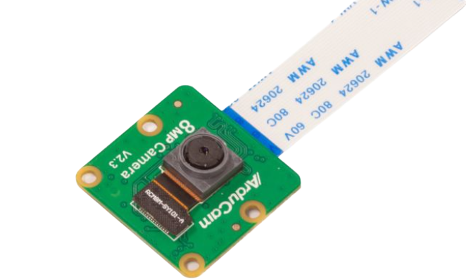
Major Component: Camera
Camera | Logitech Webcam C920 | Sony IMX219 8MP CSI Camera Module | Arducam IMX219 Visible Light Fixed Focus Camera Module
Image
Cost | $67.25 | $38.30 | $15.99
FOV | Moderate; 78° | Wide; 120° | Narrow; 65°
Power | 2.5 watts | Less than 1 watt | Less than 1 watt
Connection Type | USB | CSI | CSI
Distortion due Lense | Low | Mild, correctable with software | Low
FPS | 30 FPS | 30 FPS | 30 FPS

Slide 14
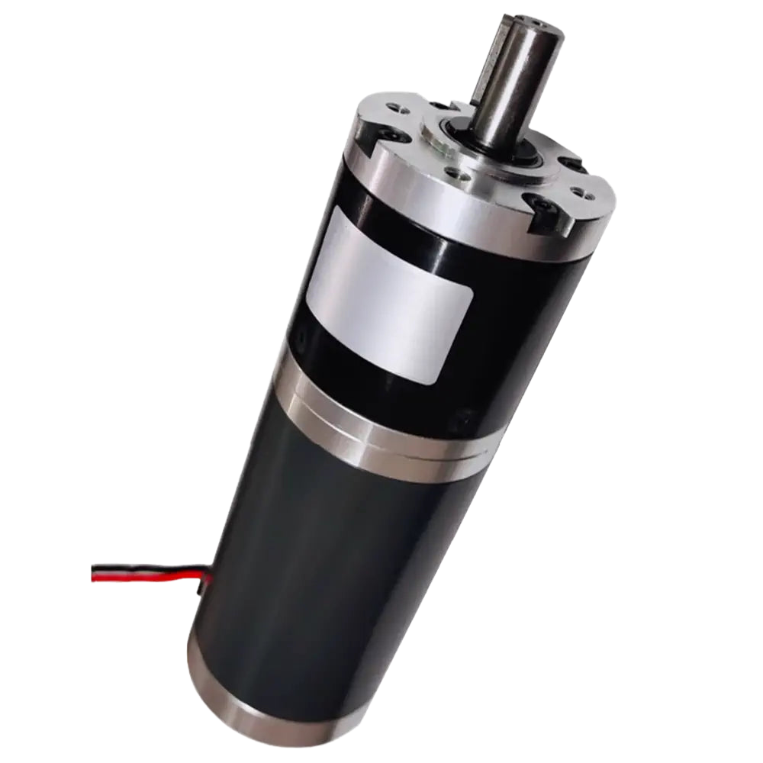
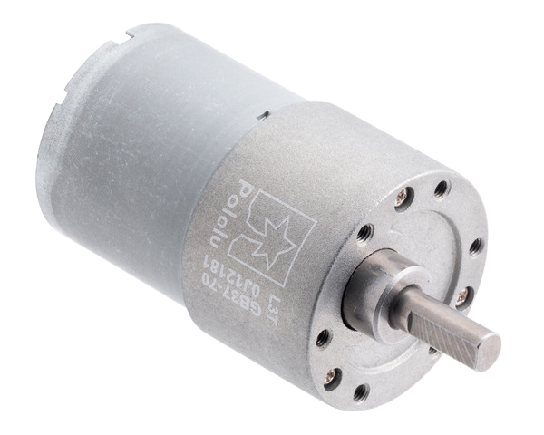
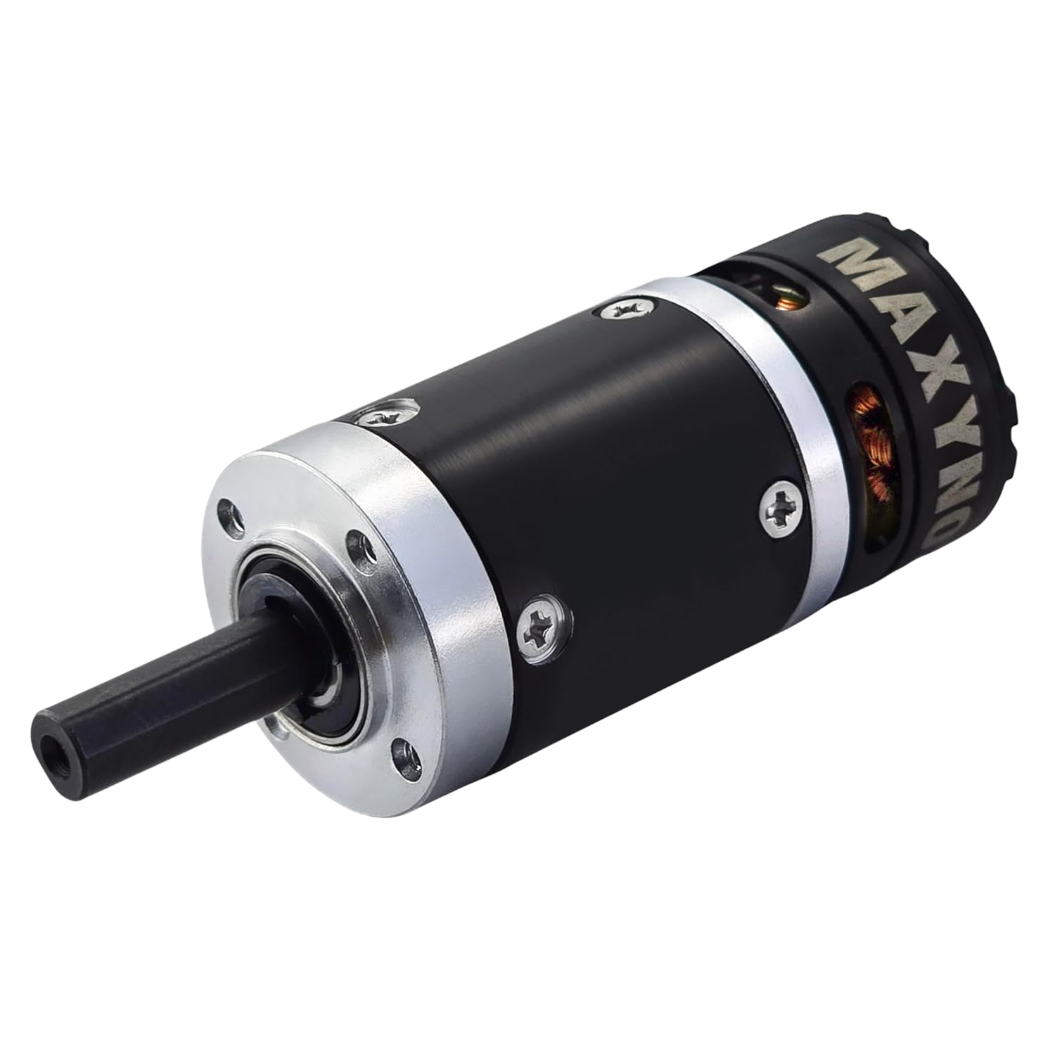
Major Component: Motor
Motor Driver | 90 watt 60D Planetary Gear Motor | 70:1 Metal Gearmotor 37Dx54L | Thor 2318 Planetary Gear Brushless Motor
Image
Cost | (1) $123.50 | (4) $143.80 | (4) $239.96
Power | 90 W | 10 W | 60 W
Rated Torque and Speed | 9.7 Nm @ 89 Rpm | 2.7 Nm @ 150 Rpm | 2.7 Nm @ 215 Rpm
Brushless | No | No | Yes

Slide 15
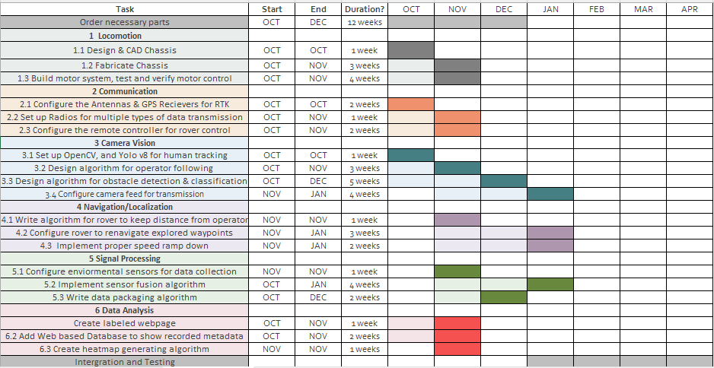
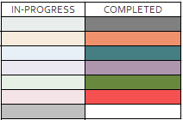
Gannt Chart
Rubric:

Slide 16
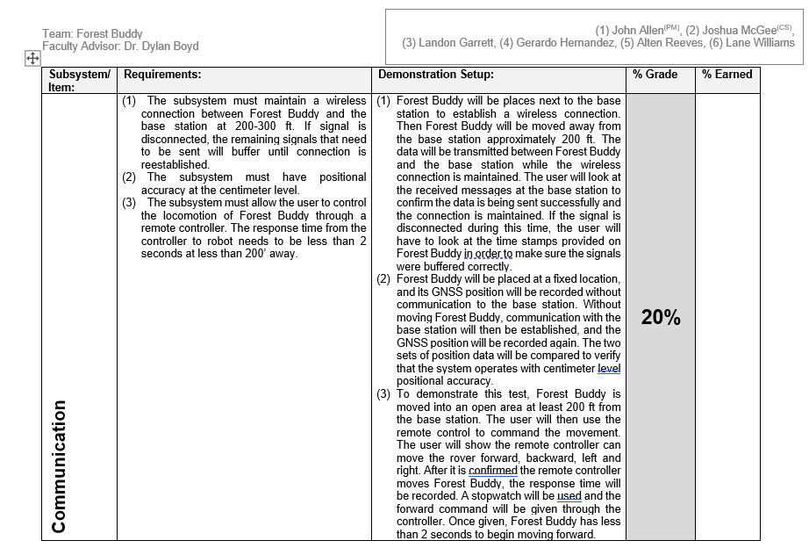
Subsystem Deliverables
John Allen ( Communication)

Slide 17
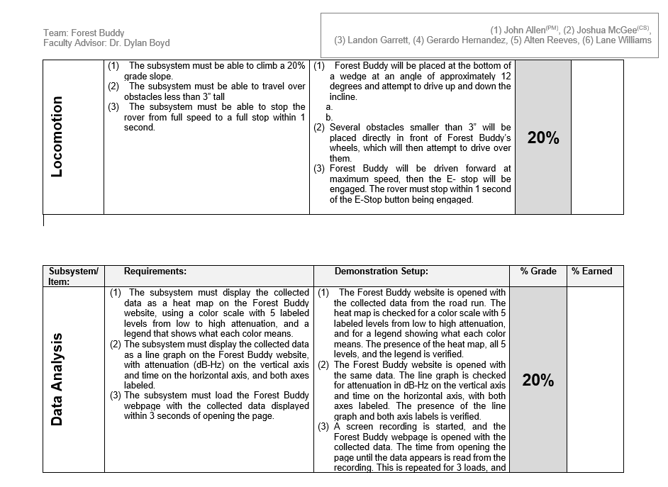
Subsystem Deliverables
Alten Reeves (Locomotion)
Gerardo Hernandez (Data Analysis)

Slide 18
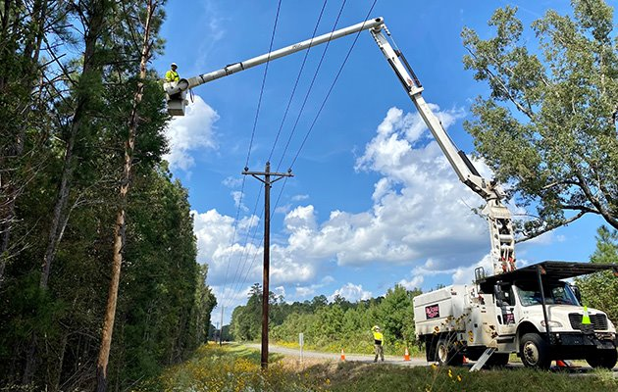
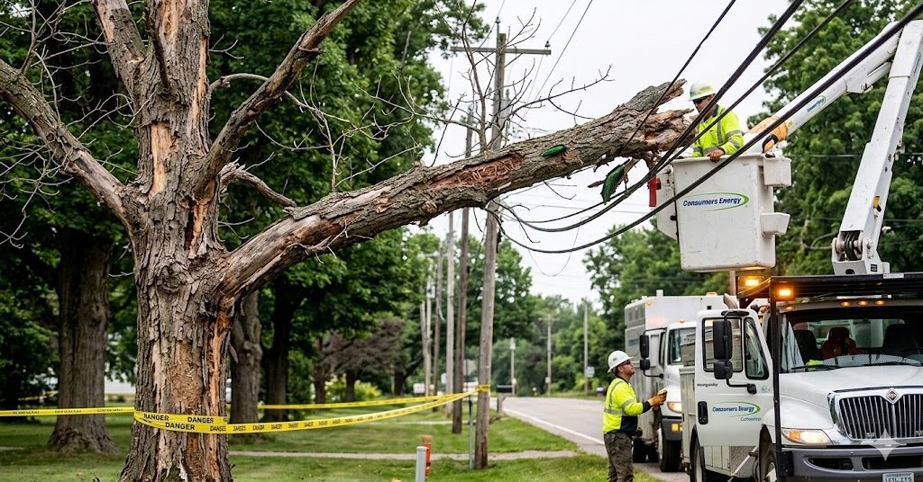

Broader Impact
Potential impacts in other fields
  Forest Buddy could help the power industry by detecting at risk trees near powerlines.
  It could help with fighting wildfires as canopy moisture data could be used for regional fire risk models.
Unlikely Byproducts
  The sensors could be changed to monitor other environmental characteristics.
Benefits for target user
Cuts labor and time costs of inspecting large quantities of trees.
Nondestructive; requires no trees to be harmed.
Catches drought and disease early.
Potential impacts in other fields
Forest Buddy could help the power industry by detecting at-risk trees near powerlines.
It could help with fighting wildfires as canopy moisture data could be used for regional fire risk models.
Unlikely Byproducts
The sensors could be changed to monitor other environmental characteristics.

Slide 19
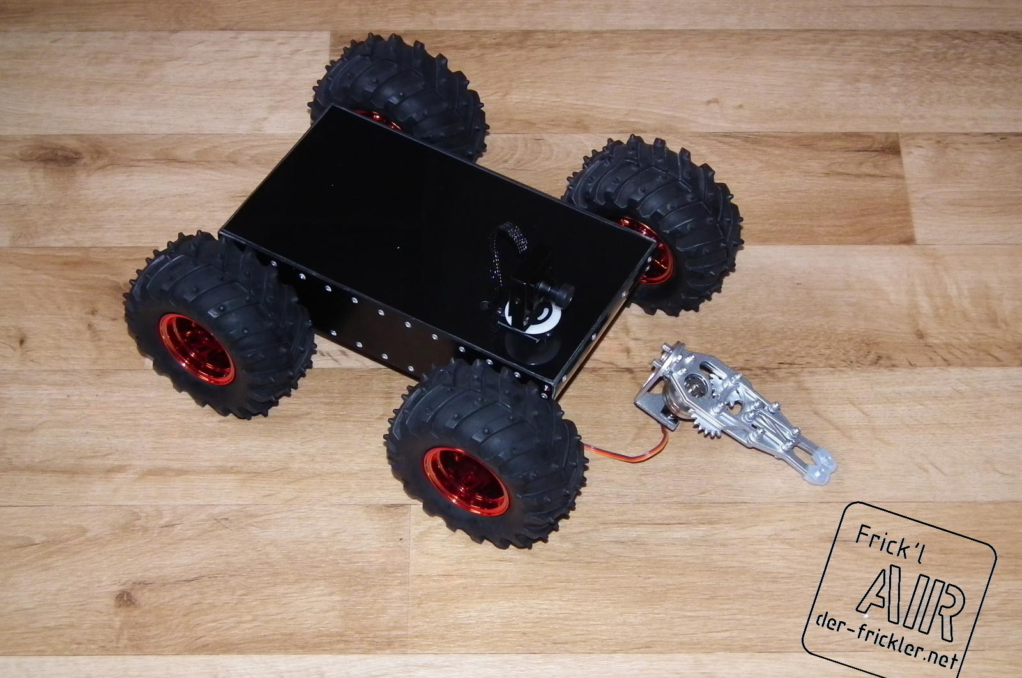
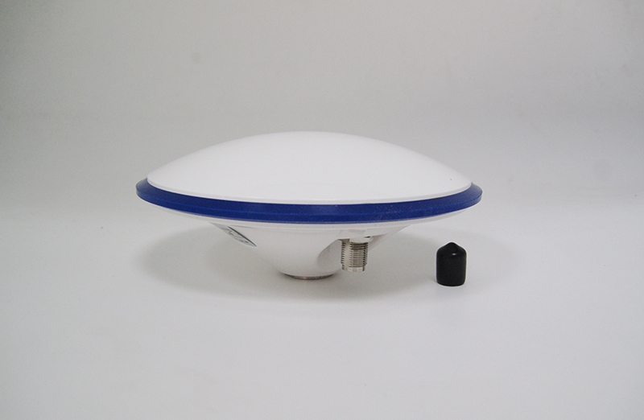
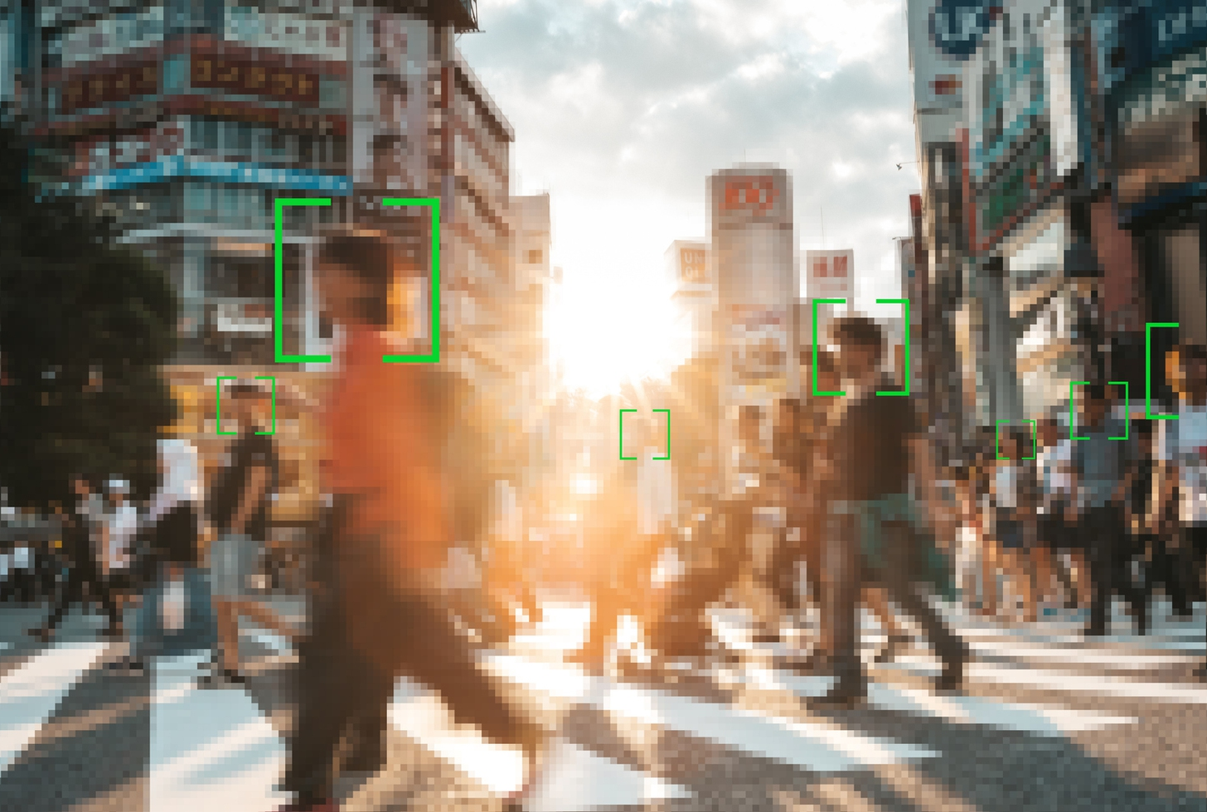
Future Work
Building the Chasey
The team must build the entire chassis first to ensure the rover can move properly and hold all materials.
Communication
Communication between the base station and Forest Buddy must be established to ensure centimeter level positioning of Forest Buddy
Yolo V8 Implementation
The team will implement Yolo V8 to ensure Forest Buddy can correctly detect a human and understand who to follow by recognizing the first person to step into frame.

Slide 20
References
[1] “Forests and a future of drought: Area exposed to severe drought projected to triple by 2070 | US Forest Service Research and Development,” US Forest Service Research and Development, 2026. https://research.fs.usda.gov/srs/articles/forests-and-future-drought-area-exposed-severe-drought-projected-triple-2070 (accessed Sept. 03, 2026).
[2] “Researchers complete first comprehensive threat assessment of all U.S. trees,” United States Botanic Garden, Aug. 23, 2022. https://www.usbg.gov/blog/researchers-complete-first-comprehensive-threat-assessment-all-us-trees (accessed Sept. 08, 2026).
[3] “FIA FAQ - Colorado State Forest Service,” Colorado State Forest Service, Jan. 27, 2017. https://csfs.colostate.edu/science/forest-inventory-analysis/fia-faq/ (accessed Sept. 14, 2026).
[4] M. Li, H. Li, X. Ding, L. Wang, X. Wang, and F. Chen, "The detection of pine wilt disease: A literature review," Int. J. Mol. Sci., vol. 23, no. 18, Art. no. 10797, Sep. 2022, doi: 10.3390/ijms231810797. [Online]. Available: https://doi.org/10.3390/ijms231810797 (accessed Sept. 8, 2026).
[5] S. Tahir, S. S. Hassan, L. Yang, M. Ma, and C. Li, "Detection methods for pine wilt disease: A comprehensive review," Plants, vol. 13, no. 20, Art. no. 2876, Oct. 2024, doi: 10.3390/plants13202876. [Online]. Available: https://doi.org/10.3390/plants13202876 (accessed Sept. 8, 2026).
[6] IEC, Degrees of protection provided by enclosures — IP code, IEC 60529, 20th ed., Geneva: International Electrotechnical Commission, 2020. (Accessed 6 Oct. 2026).
[7] ISO. ISO 13850:2015 Safety of machinery — Emergency stop function — Principles for design. ISO.org. (Accessed 6 Oct. 2026).
[8] International Organization for Standardization/International Electrotechnical Commission, “ISO/IEC 17123 — Calibration and verification of measurement devices,” ISO/IEC 17123, 1st ed., 2023, pp. 1–120. Available: https://www.iso.org/standard/62085.html. (Accessed: Oct. 6, 2026)
The Forest Buddy team acknowledges the use of ChatGPT in preparation for this assignment including proof reading and general statements.

Slide 21
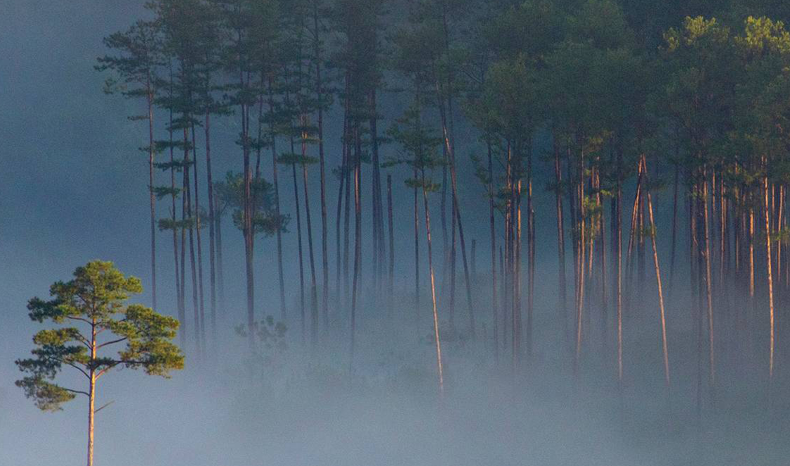
Thank you
Questions?

